Slide 1

PROJECT PRESENTATION
STEFANO COSTANZO (AA SPECIAL SESSION 2021)

Slide 2
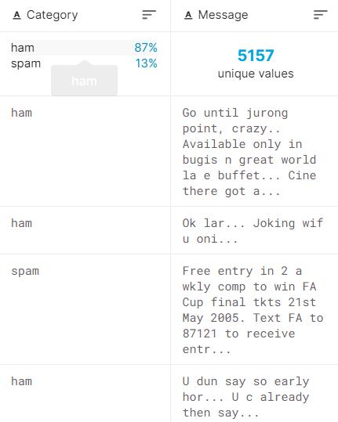
INTRO TO THE PROJECT
What we have:
Dataset of 5157 email with two column:
Category (ham or spam)
Message
Proportion: 87% ham, 13% spam
What we want to do:
Create an email spam detetion system using machine learning techniques

Slide 3
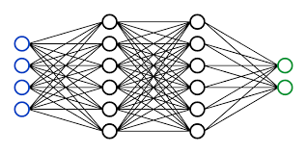
What algorithm?
Supervised learning best possibility - Logistic regression
Classification problem - Neauronal network
Neauronal network
Quite robust to noise in the training data:
Email context have a lot of noise
- Strong flexibility in configuration

Slide 4
How it works?
X : num_entradas (1000-15000 features) are words indicative of spam/ ham
Y: Ham (1) or Spam (0)
1 if appears in the email
Xi = X_words: (m, num_entrads)
0 if not

Slide 5
Step 1:
Start with the simplest implementation: NN with less num_entradas (about 500) and num_ocultas (about 25). Only one hidden layer. Small amount of iterations of the NN
Dividing dataset in 2 parts: Train (80%) and Test (20%)
Assume as important measurements the accuracy and the recall (because of the unbalanced categories)
-> Importance recall: Unbalanced dataset, importance to not categorize normal email has spam
Initial situation: 95% accuracy, 98% recall (don’t give many small false spam email)

Slide 6
Step 2.1:
Improve the model: Find the correct num_ocultas for the hidden layer
Increase the dimension of the NN to reach the overfit limit (when the results begin to get worst)
3 Charts 3-D: Accuracy, recall, precision

Slide 7
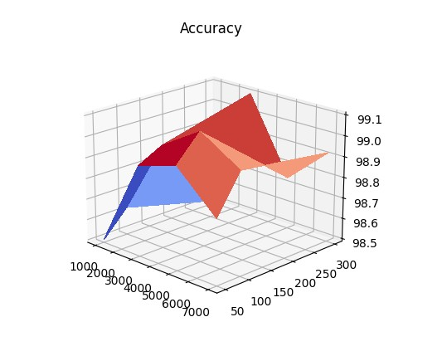
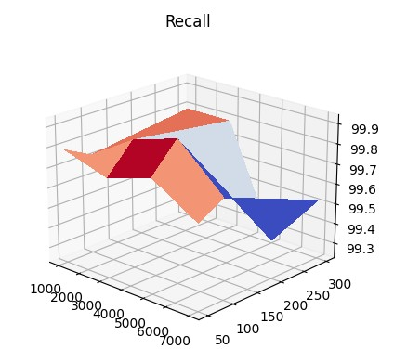
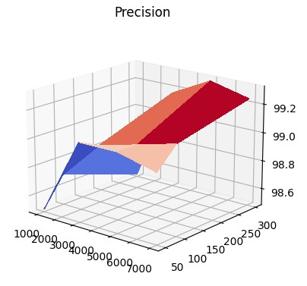
Step 2.1:
3 Charts 3-D: (x = num_entradas, y = num_ocultas, z = (accuracy, recall, precision))
X = (1000-7000), y = (50-300)
Good compromise: Num_ocultas = 100-200

Slide 8
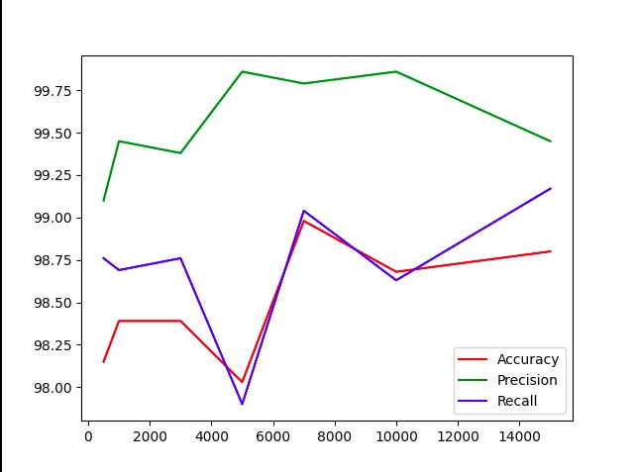
Step 2.2:
2-D chart: X = num_entradas, y = Percentage
K-validation for the train_set
Because of the small amount of examples
(about 5200)
Applied k = 5, num_ocultas = 100
Try to find the best num_entradas (num X)
-> Good compromise (not overfit): 6000-7000

Slide 9
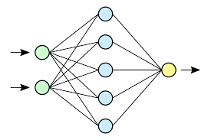
Step 3:
Evaluate the results: with num_entradas = 5000, num_ocultas = 1000
NN scheme:
100
5000
2

Slide 10
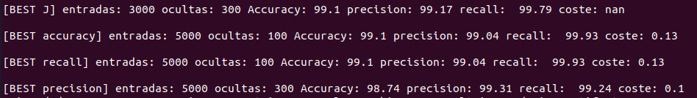
Step 3:
Evaluate the results: Best accuracy and recall
with num_entradas = 5000, num_ocultas = 1000
Accuracy: 99.01
Precision: 99.08
Recall = 99.79
Coste: 0.11

Slide 11
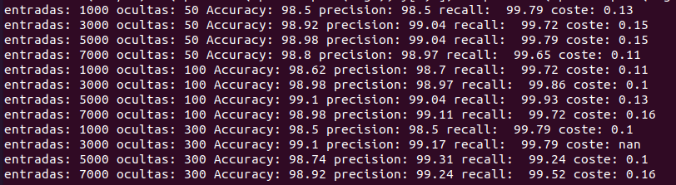
Console

Slide 12
Let’s take a look to the code…

Slide 13
Limitations and restritions
System based only from one source of example: Can be good for this case but weak for another Spam generator
Not regularization: Because is a difficult concept to apply at the case: Give more importance to some words to indicative of spam/ ham
The email detection needs a lot of calculation for a NN so is difficult to form detailed and heavy chart
The dataset doesn’t expose the typology of email: It can help to undestand the «white box»

Slide 14
Future works
Improve all the weakness of the system:
Add Steamming (example with NLTK) to give robustness to the system
Surpass spam «smart» decision: Capital character, designations, small ortographic error, etc.
Regularization

Slide 15
Thanks

